Slide 1
Exploring Customer satisfaction
IST 687
Ishita Joshi, Leah Singer, Wei Mu, Xin Sun, Zhenlei Liu
Notes:
Presentation:
1% Business question
1% Use of descriptive stats
1% Use of modeling techniques
1% Visualization
1% Interpretation/actionable insight
1% Know your audience
Articulate what data you chose and why

Slide 2
Business Question
Which demographics of people should we focus on to increase the overall satisfaction?
How did arrival delayed affect the customer satisfaction?

Slide 3
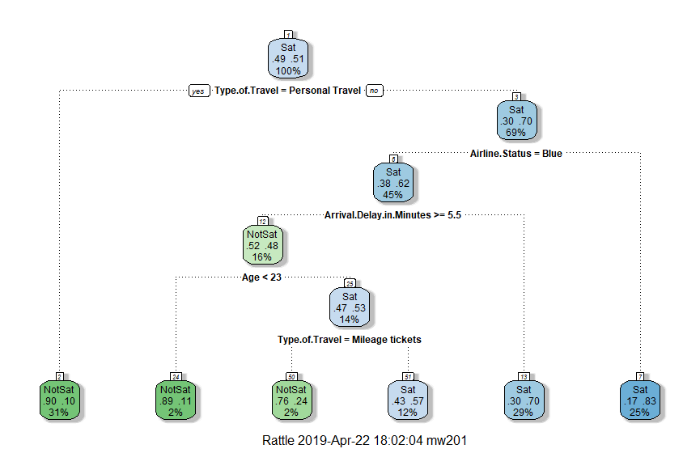
Decision Tree:
Define >=4 as Satisfied,
<4 as not satisfied
Splitting index=’gini’
cp=0.01
Model techniques
Notes:
Decision Tree is a Machine Learning algorithm covering classification and regression problem. In this example we create two buckets by defining… It automatically selects a set of variables that is important/ influential on whether the customer is satisfied or not.
In this graph, for each node, left means yes, and right means no. The darker the color, the more significant the conclusion is.
We can see that Personal travellers are very likely to be not satisfied. And the Airline status which is not blue is likely to be satisfied. And whether arrival delay is more than 5.5 matters for non-personal travellers who has a airline status of Blue.

Slide 4
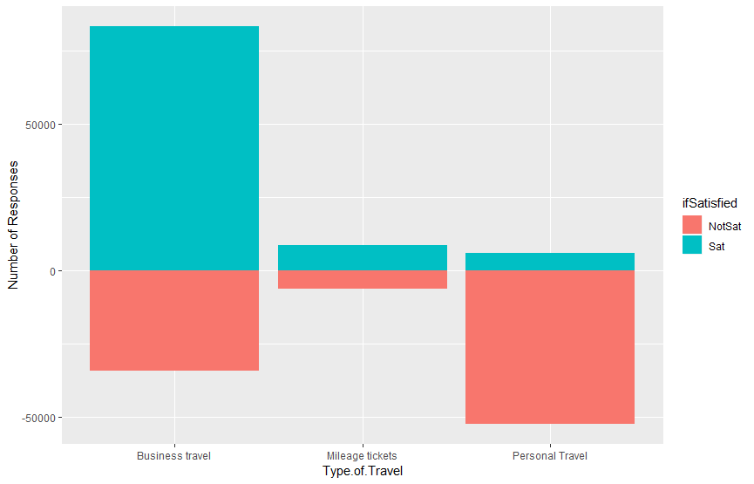
Personal travelers are not satisfied

Slide 5
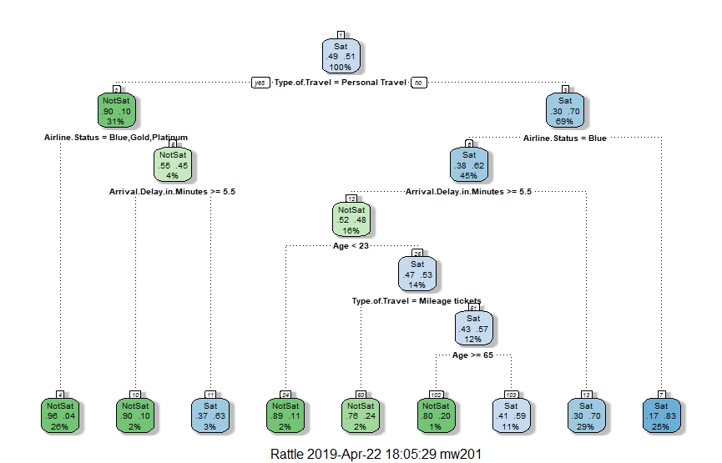
Fully Grown Tree
cp=0.005
Notes:
The previous graph was a pruned tree.
This graph provides more info on personal travellers- the arrival delay in minutes(whether it is >5 min) is also an important factor for Silver customers who are going for personal travels
Business traveler who is more than 65 years old and has airline status of blue is very likely to be not satisfied when arrival delay is more than 5 minutes.

Slide 6
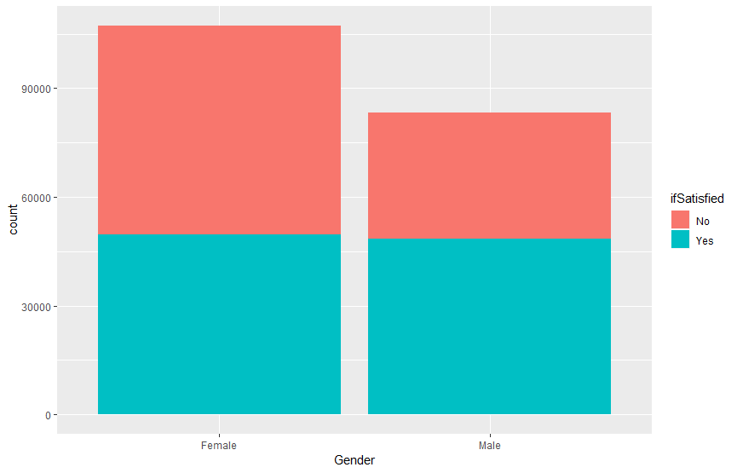
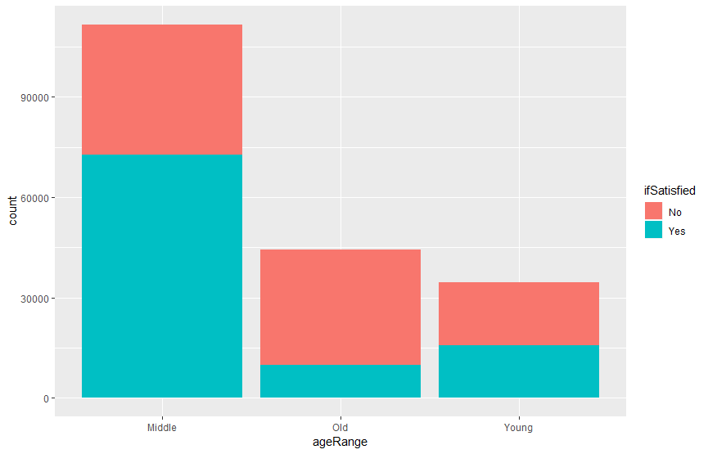
Gender and Age Analysis
Notes:
Females have higher proportion of not satisfied customers
Old people are not satisfied

Slide 7
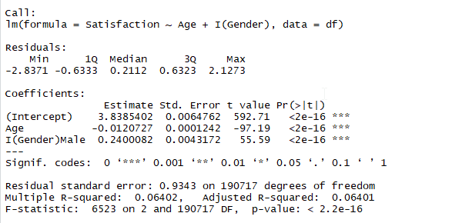
Linear regression
With other factors constant, if the customer has a higher age, the customer gives lower satisfaction score.
If everything else is the same, male customers gives higher satisfaction score.
In general, the conclusion is the same as conclusions from the visualized graphs.
Notes:
Higher the age, lower the satisfaction

Slide 8
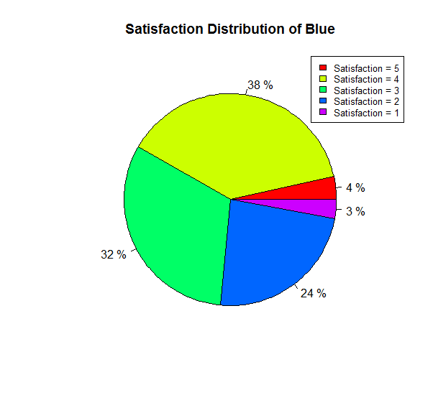
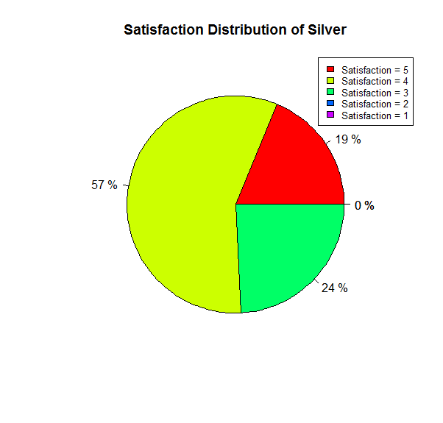
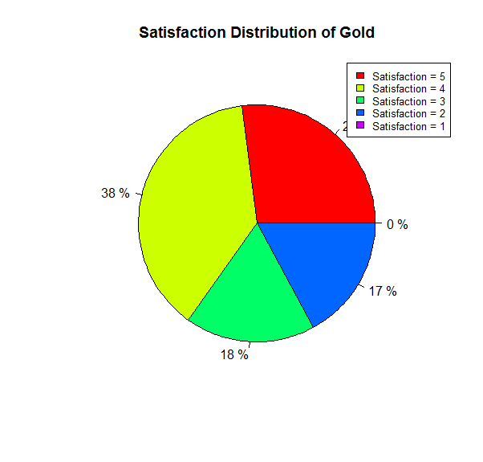
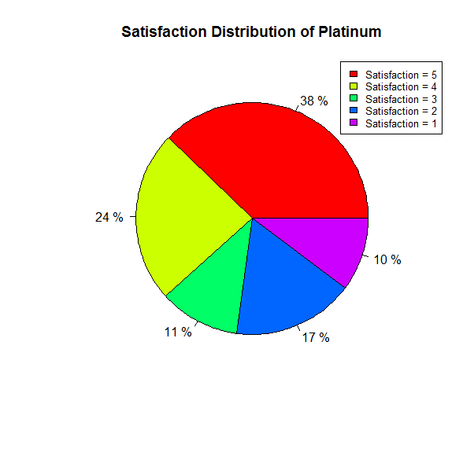
Airline Status
Blue and Platinum customers have the highest proportion of dissatisfied customers
Blue also has the lowest high satisfaction rate (5)= 4% comparing with other airline status 19% - 38%

Slide 9
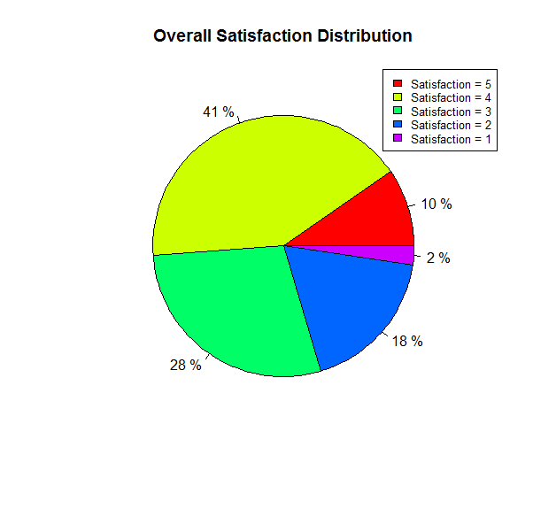
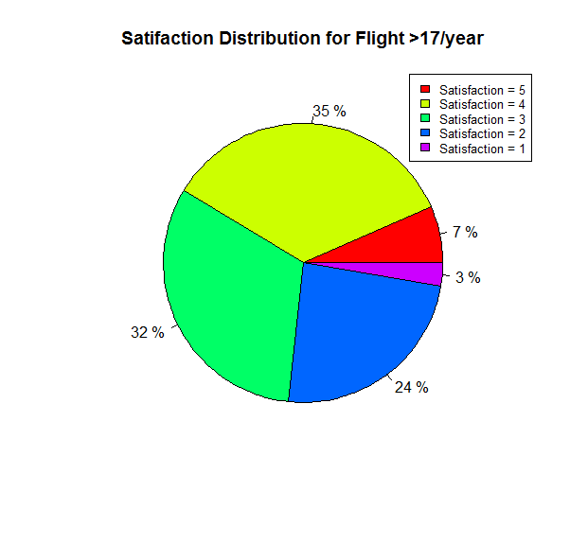
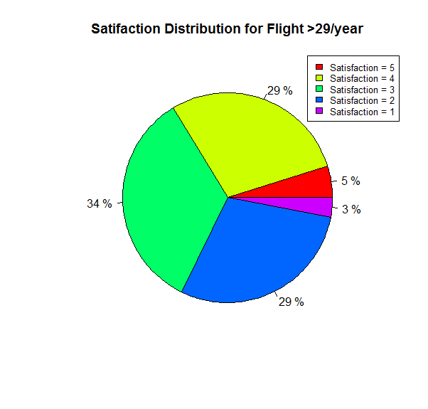
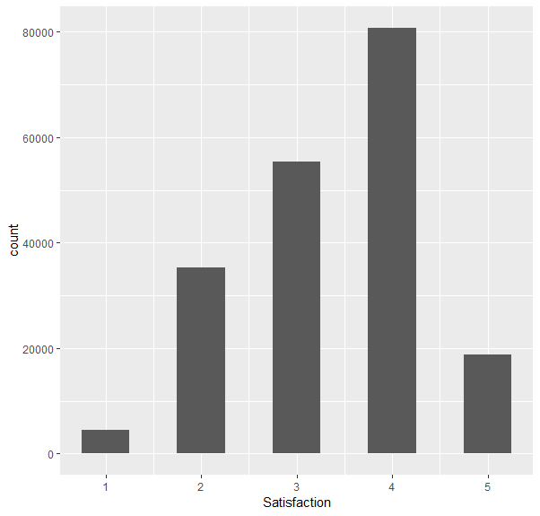
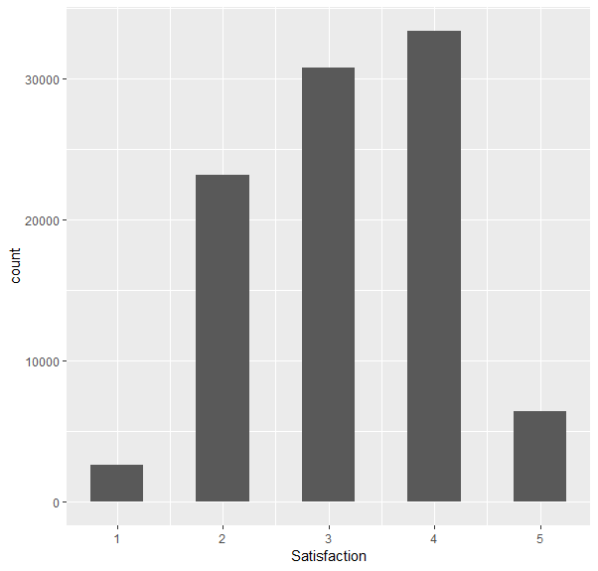
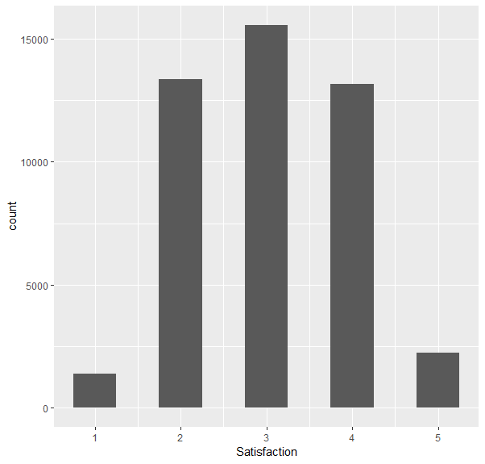
Flight Per Year
With increasing of flight times per year, the customers were more sensitivity to the service.
They have the trend to give dissatisfaction rating (<4)

Slide 10
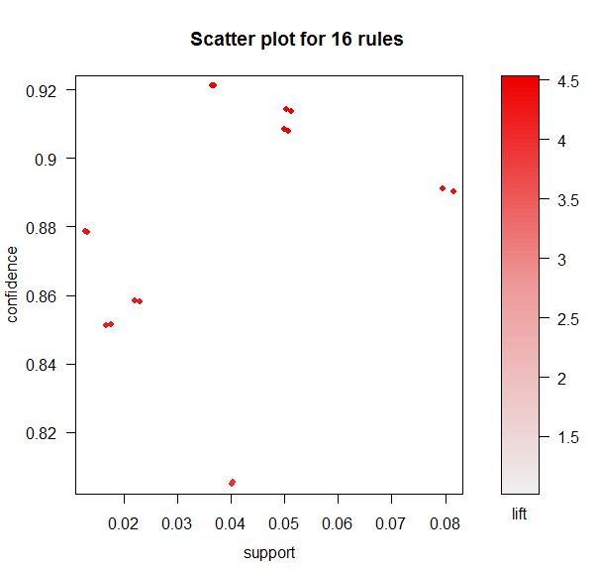
Associate Rules
Six features was investigated in associate rules:
Age
Arrival Delay
Travel Type
Airline Status
Price Sensitivity
Flight per Year
The top 5 rules indicated there is over 90% confidence that the custom with these features giving dissatisfaction (<3) rating:
Arrival Delay > 5 min
Airline status is Blue
Low Price sensitivity (<3)
Personal Travel

Slide 11
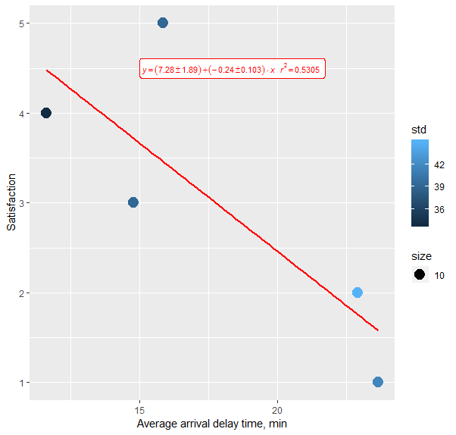
Arrival Delay
We calculated the average arrival delay time for each satisfaction level.
The decreasing satisfaction level was related to the increase in average arrival delay time.
The satisfaction and average arrival delay time follow a linear model with R-square = 0.53

Slide 12
Results and discussion
1. Personal travellers
-How can we improve their experience?
2. Arrival delay >5 minutes
3. Blue customer
-How can we improve their experience?
4. Older customers?
-How can we improve their satisfaction?
Notes:
Suggestions: Travel deals
Try to avoid delays, be honesty and communicated with customers
Blue customers: offer more perks for this “lower level” customer class to make them feel happier
Older customers: offer senior discounts
Offer perks and benefits before they take the survey

Slide 13
Thank you

